Slide 1

How to involve third parties in preventive policing in combatting trafficking in human beings
Dr. J.J.M. (Jorn) van Rij ph..

Slide 2
How to involve third parties in preventive policing in combatting trafficking in human beings
Opportunities and Challenges

Slide 3
Welcome
Introduction
Human Trafficking
Policing and Prevention
P’s Paradigm
Partnerships
Opportunities and Challenges
Academia

Slide 4
Introduction
Senior Researcher Human Trafficking
Netherlands National Police
Visiting professor
PTE-AJK
Committee member
Serious Crimes Compensation Fund
Founder and Board Member
- Reshape Foundation

Slide 5
Human Trafficking
Article 3, paragraph A. of the UN Protocol to Prevent, Suppress and Punish Trafficking in Persons Especially Women and Children, supplementing the United Nations Convention against Transnational Organized Crime of 15 November 2000
and in addition on a European level:
Article 2 of Directive 2011/36/EU of the European Parliament and of the council of 5 April 2011 on preventing and combating trafficking in human beings and protecting its victims.

Slide 6
Human Trafficking (2)
Three elements
Two components
The ACT (what is done by the trafficker to…)
recruitment, transportation, transferring, harboring or receipt of a person;
The MEANS (how, which methods are used?)
threat, use of force, coercion, abduction, fraud, deception;
The PURPOSE (why did it happen?)
exploitation, including sexual exploitation, forced slavery and slavery like practices.
Vulnerability
‘this is a situation in which the person concerned has no real or acceptable alternative but to submit to the abuse involved’.
Exploitation
‘is prostitution or other forms of sexual exploitation, forced labour or services, including begging, slavery or practices similar to slavery, servitude, or the exploitation of criminal activities or the removal of organs’.

Slide 7



But … remember the Δ
Sexual exploitation
Labour exploitation
Criminal exploitation
Trafficking of Organs
Exploitation of surrogacy
Forced Marriage
Illegal Adoption

Slide 8
Policing and Prevention
Existing problems:
Reactive (classic) policing styles
Conceptual difficulties
Convergence issues
Limited research (Validated and Realtime)

Slide 9
Policing and Prevention (2)
A combined approach:
Traditional policing strategies (evidence based & intelligence led)
Online investigations
Information gathering and data sharing
Upstream disruption (preventive measures/programs & trainings)
PPP

Slide 10
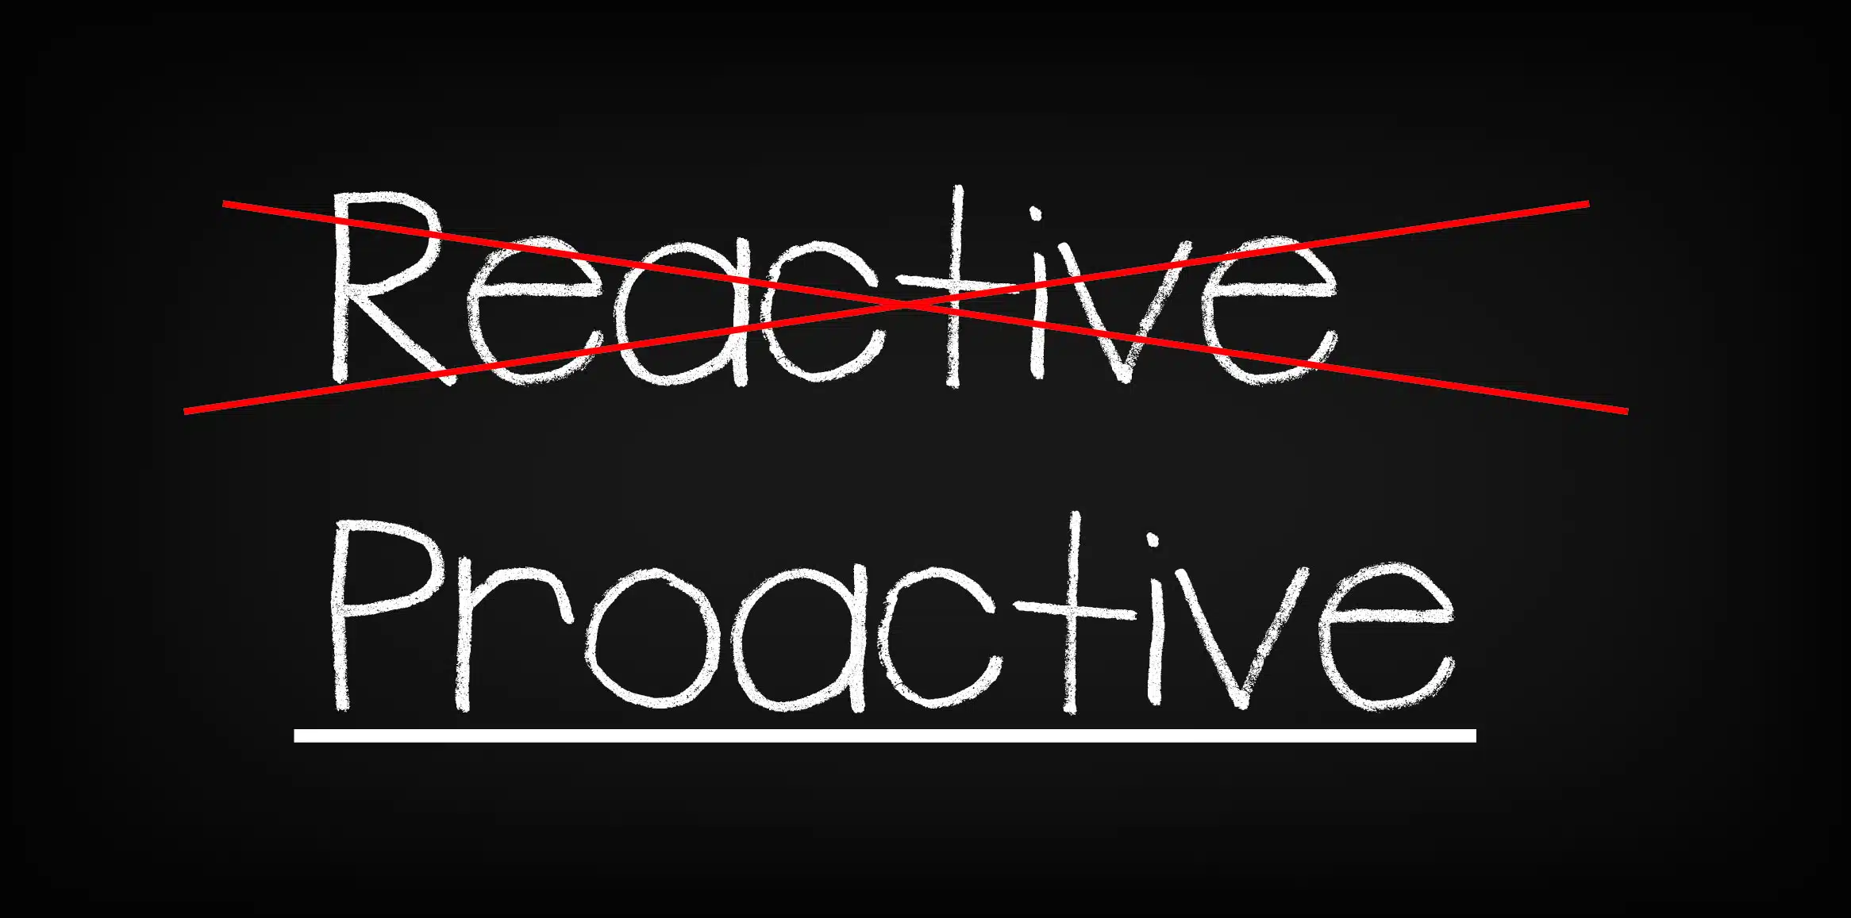
P’s Paradigm
Prevention
Protection
Prosecution
Partnerships

Slide 11
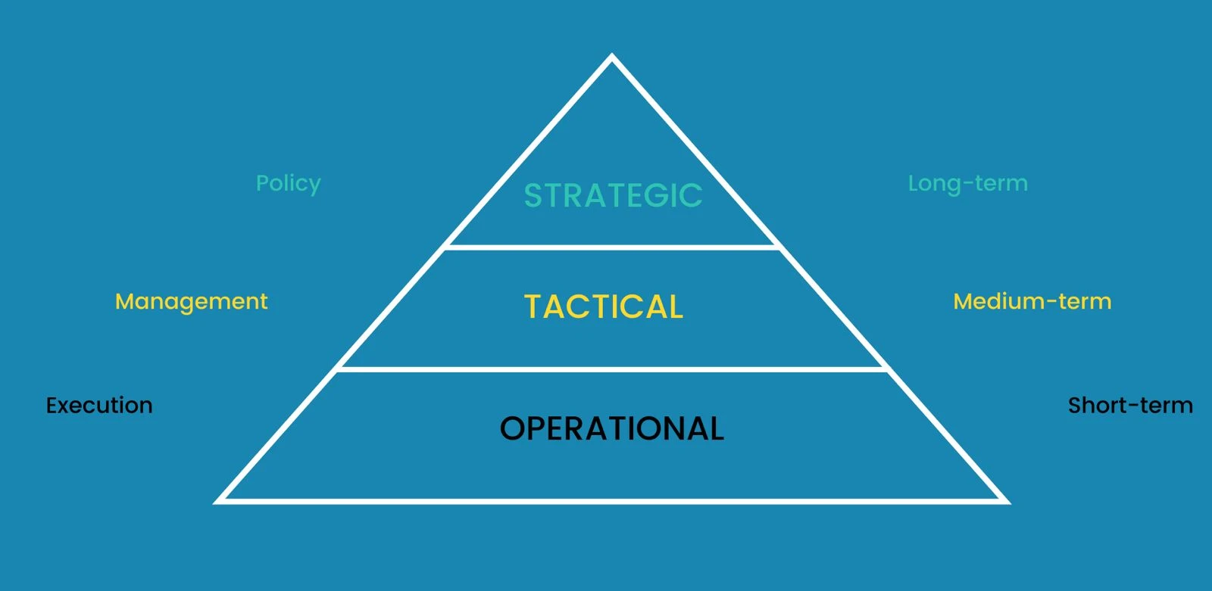
Partnerships
Selection criteria (PPP)

Slide 12

Opportunities and Challenges
Common goals
Technological advancements
Reciprocity
Sustainability
Regulatory limitations
Cultural Differences
Intrinsic motivation
Matching results
Equality, Trust, Honesty, Loyalty, Respect or Nolens Volens

Slide 13






Academia

Slide 14
Thank you
And have an inspiring conference

