Slide 1

The European Anti-Trafficking Program: a model to stop cross-border human trafficking in the EU’
Ștefan Coman, Partnerships & Advocacy Lead
International Justice Mission Romania

Slide 2
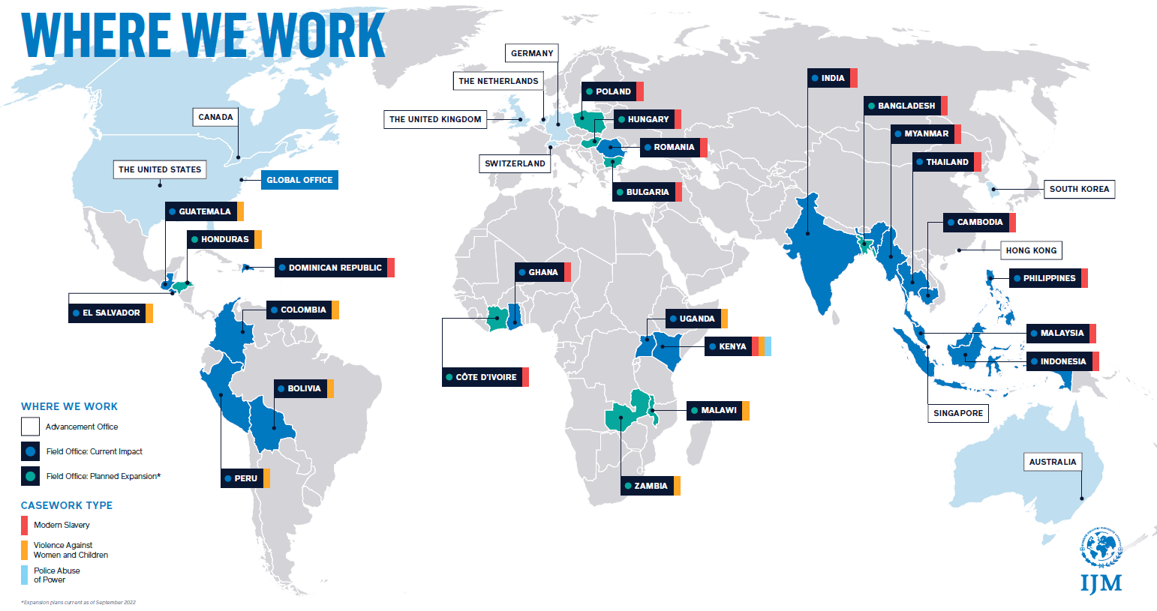
About International Justice Mission

Slide 3
About International Justice Mission
IJM is a global organization that protects vulnerable people from violence by protecting victims, supporting to bring criminals to justice, restoring survivors and helping local law enforcement build a secure future that lasts.
  IJM uses a collaborative case work approach, using multidisciplinary teams of law enforcement liaison officers, lawyers, criminal analysts, social workers to support cases of exploitation.
  IJM cases are a diagnostic tool that informs program, advocacy and capacity building activities. This approach is grounded on realities in real cases. IJM values lived experience survivors who help develop and input into our programming and approaches.

Slide 4

Context and Problem Analysis

Slide 5
Situational Overview
According to a recent Europol report:
Member States and third countries identified a total of 821 most threatening criminal networks active in the European Union.
76% of the most threatening criminal networks are present or active in two to seven countries.
The leadership of 82% of OCGs is settled either in the main country of activity or the country of origin of the key members.

Slide 6
Situational Overview
According to a recent Europol report:
Investigations should mirror the agility and resilience of criminal network by employing proactive and all-encompassing approaches.18 Law enforcement is therefore urged to strengthen their partnerships with other actors to form comprehensive approaches.
Cooperating on an international and interregional level to counter the borderless aspect of criminal networks, initiated by dedicated collaborative structures and partnerships.

Slide 7

European Anti-Trafficking Program

Slide 8
PROGRAM VISION:
Strengthened and coordinated justice systems protect vulnerable populations from trafficking, both domestically and across Europe.

Slide 9
EATP Program Pillars
Vulnerable populations are protected from cross-border trafficking
PILLAR 1
EUROPEAN CROSS-BORDER COLLABORATION
PILLAR 2
STRONG CRIMINAL JUSTICE SYSTEM RESPONSE
PILLAR 3
EMPOWERED SURVIVORS

Slide 10
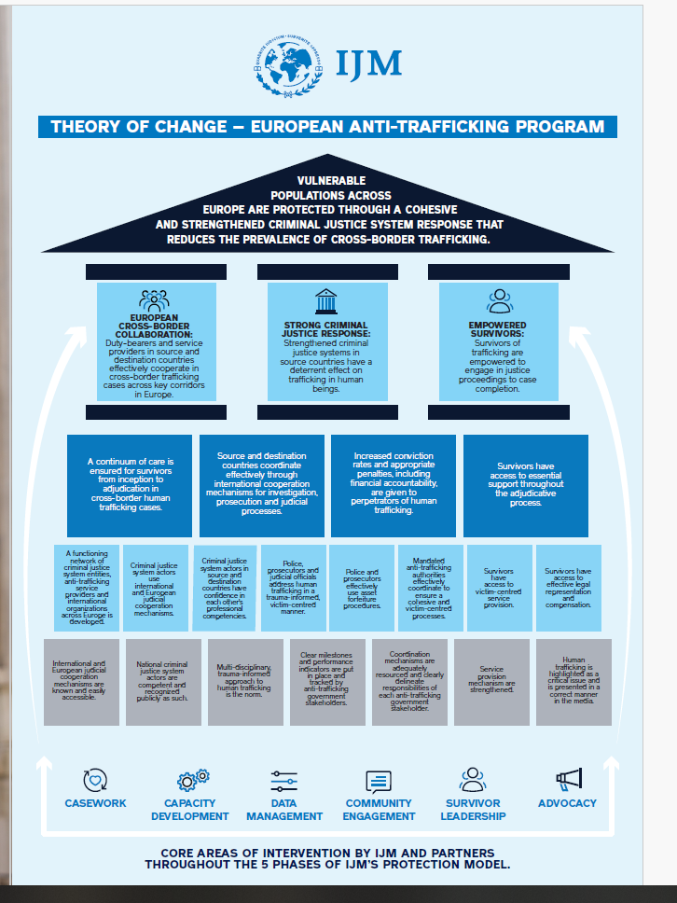
EATP Theory of Change

Slide 11
Highlights 2021 - 2024
740+ CJS actors
450+ specialists
Police, prosecutors and judges trained
Social workers, Psychologists, ANITP trained
127 arrests
147 survivors
116 prosecutions
Receiving support and legal assistance
40+ convictions
For Human Trafficking offences

Slide 12
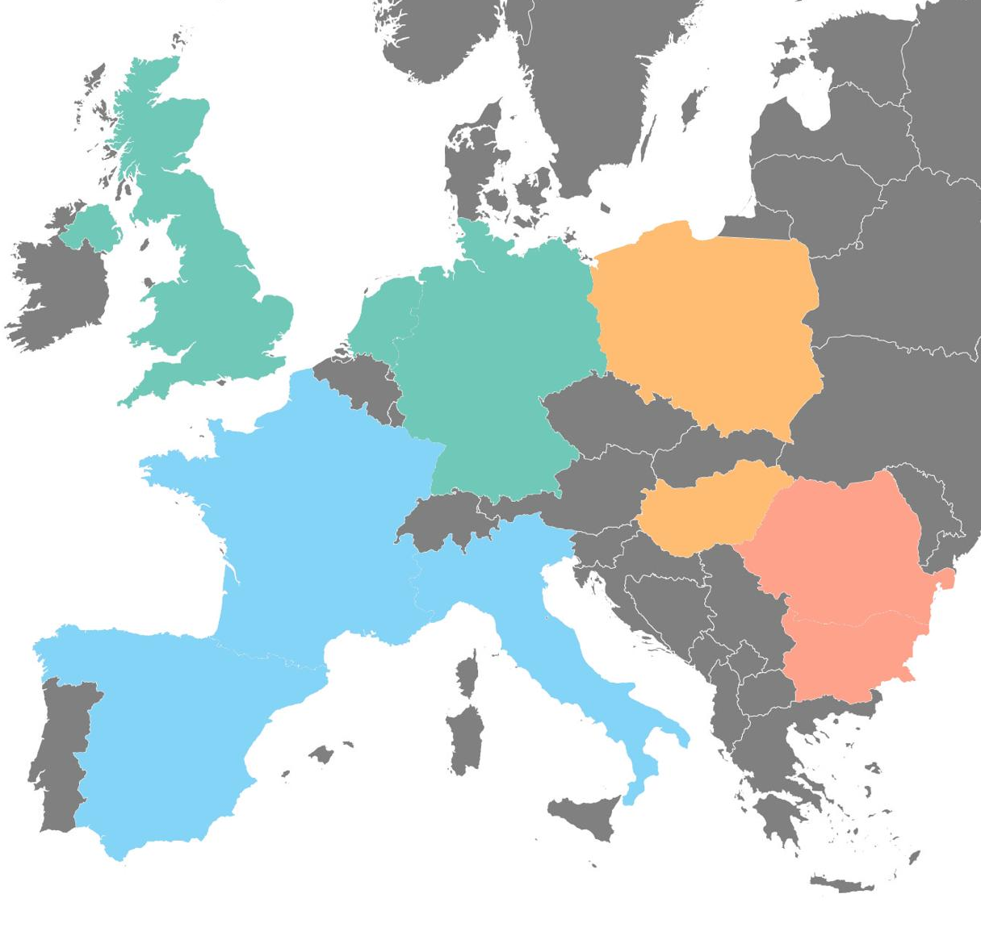
Where We Operate
IJM is currently operating in Romania and supporting cross-border trafficking cases as they relate to the UK, Germany and the Netherlands.
IJM is working through partners in Bulgaria and has secured registration in Poland.
IJM will at a later stage expand operations to Hungary, Spain, Italy and France.
UK
Netherlands
Poland
Germany
France
Hungary
Romania
Italy
Bulgaria
Spain

Slide 13
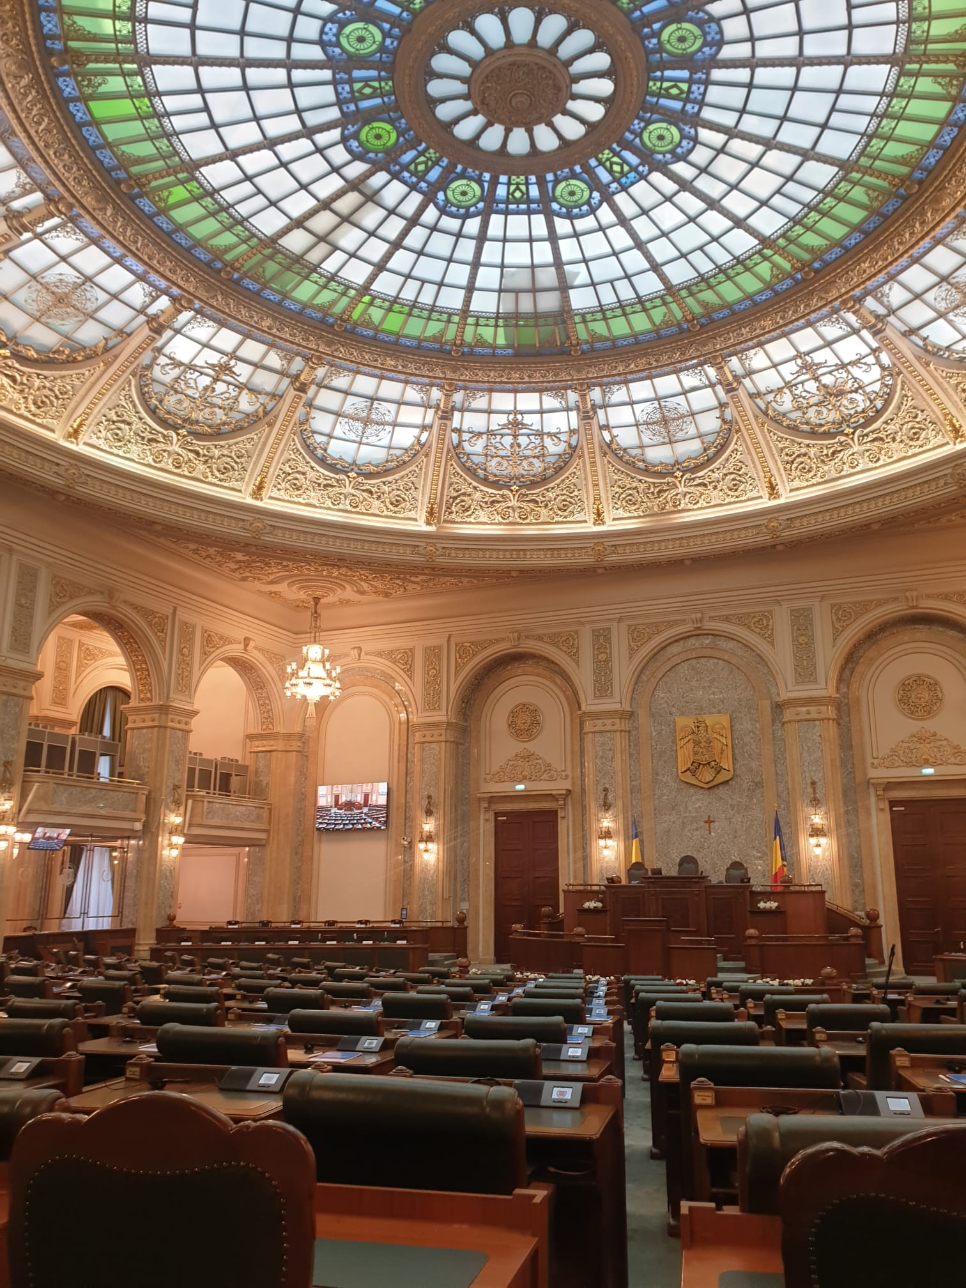
Activating Agents of Change & Advocacy

Slide 14

Highlights
Engagement and buy-in at highest government level.
Coordinating the evaluation reporting of the National anti-THB strategy 2018-2022 and advising on new TIP strategy.
Policy changes informed by cooperation with relevant criminal justice system actors.
Collaborative approach with civil society.

Slide 15



Slide 16


Legislative Changes
Changes to the criminal code:
  Law 202/ 2024 – increased sentencing, elimination of suspended sentences
  Law 269/2024 – forced pimping becomes human trafficking (and jurisdiction changes)
Law 272/ 2024 – increased access to rights (including compensation) for victims
Currently working on updating criminal procedure code – growing efficiency and improving procedures linked to digital evidence

Slide 17

IJM’s Theory of Change

Slide 18
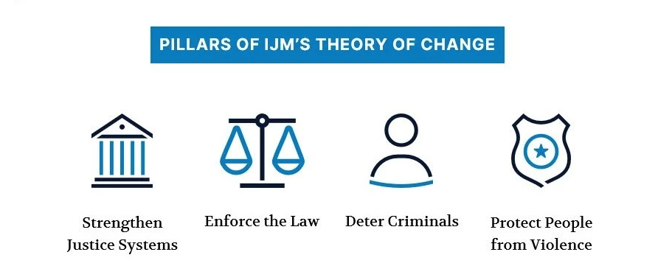
IJM’s Theory of Change

Slide 19
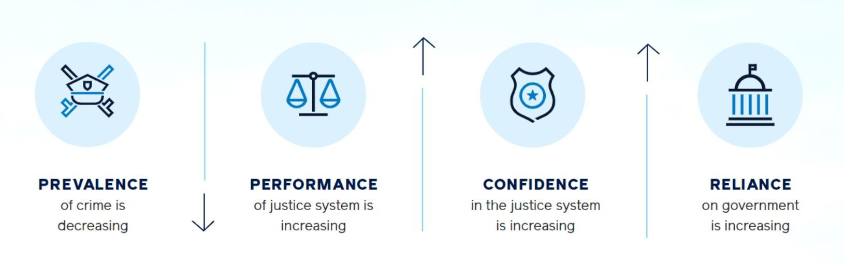
Protection Measurement Framework
Protection: the array of benefits that accrue to people in poverty through a strengthened justice system.
People are protected from violence when the justice system acts as a deterrence to perpetrators; is attractive for victims to report crimes and pursue cases; performs well on those cases; and has the confidence of key stakeholders.

Slide 20

Stakeholder Confidence
Key stakeholders’ confidence in the justice system (JS) to protect people from the targeted forms of violence.
Power + Voice: Persons who are powerful and influential that the Government can listen to their voices as an input in the management of justice system
Beliefs/Perception: Stakeholder Confidence is in essence the perception of key stakeholders regarding the effectiveness, efficiency, and fairness of justice mechanisms
Criteria for Identification: (1) Competence, (2) Interest (3) Influence
The study seeks to answer the following research questions:
“What is the proportion of key stakeholders who are confident in the overall effectiveness of the justice system in Bulgaria in protecting vulnerable people from human trafficking and deterring the crime?”

Slide 21
Why do We Seek to Measure Stakeholder Confidence?
Stakeholder Confidence is both evidence of and contributes to the impact of the justice system.
A strong SC environment enhances JS effectiveness in protecting vulnerable people from violence.
SC data complements JS Performance data by showing whether perceptions are improving or declining.
It helps identify key service delivery gaps and challenges within the JS.
These insights inform continuous strategy improvement, aligning IJM interventions with stakeholder feedback.

Slide 22

Justice System Performance
The Performance Domain measures the justice system’s demonstrated capacity and will to effectively protect people. Specifically, it measures how the justice system performs on:
case progression;
application of desired behaviours and attitudes of justice system actors
The study seeks to answer the following research questions:
What challenges do criminal justice systems face in managing cross-border human trafficking cases?
Are there any gaps in information-sharing, investigations and prosecutions?

Slide 23
Why do We Measure Justice System Performance?
Build evidence of justice system strengthening.
See progress towards and achievement of protection.
Make informed, strategic improvements to programming over time.
Aggregate and compare results from projects, programs and regions.

Slide 24

People’s Reliance
The degree to which vulnerable people rely on the justice system for protection (Measured as % of the target population).
People’s Reliance is a measure of vulnerable people’s dependence on the justice system to protect them from violence.
In IJM’s work, vulnerability is deemed to exist where there is both risk of violence as well as the condition of living in poverty.
The study seeks to answer the following research questions:
What is the proportion of human trafficking incidents that are reported to relevant justice system agencies in Bulgaria?
What proportion to non-justice system agencies?

Slide 25
Why do We Measure Reliance?
IJM’s model of work is to protect people through strengthened justice systems.
Reliance on the justice system is a strong indicator that people have a social and legal recognition of the justice system and are willing to respect the rule of law rather than use extra judicial methods in resolving their complaints.
It also means that people are committed to engaging with the criminal justice system to hold perpetrators of violence accountable for their crimes.

Slide 26

Prevalence
Prevalence is an impact-level indicator which will measure the percentage of the target population that are/were victimized in Bulgaria.
The study seeks to answer the following research questions:
What is the prevalence of cross-border human trafficking originating in Bulgaria, and directed towards Western Europe?
What proportion of Bulgarians are trafficked to Western Europe for labor and commercial sexual exploitation?
Prevalence of violence

Slide 27

Why do We Seek to Measure Prevalence?
Establishes starting point to measure decline in victimization of x crime.
Tracks effectiveness of protection model by measuring decline in victimization.
Alignment with IJM’s Theory of Change: Strengthening justice systems reduces prevalence.
Enables future measurement attribution.

Slide 28
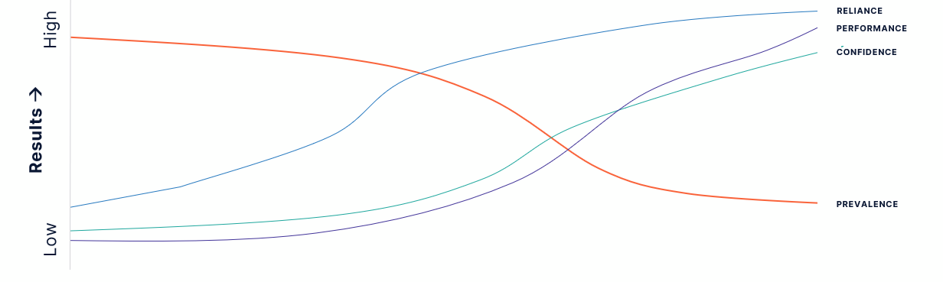
Conclusion
Goal: Decline in prevalence-post protection model and increase in performance, reliance and confidence.

