Slide 1

Can prevention be standardised? Research on Public awareness and prevention campaigns on human trafficking and the Bulgarian experience
Ernesta Rousseva, NCCTHB Bulgaria

Slide 2
Introduction
“Public awareness and prevention campaigns on human trafficking”, Department of Media and Communications, NBU
Human trafficking is a global issue rooted in historical injustice and modern exploitation
Prevention is a vital component of counter-trafficking strategies
Exploring the potential for standardising prevention efforts

Slide 3
Legal and Strategic Background
Robust international, EU, and national legal frameworks:
Palermo Protocol, CoE CATHB, Directive (EU) 2024/1712 (Directive 2011/36/EU)
Complemented by action plans: UN Global Plan, EU Strategy (2021–2025), national strategies and action plans (BG National Strategy (2017–2021)
Prevention is included as a key pillar

Slide 4
Research Objectives
Map and compare public awareness and prevention initiatives globally, at the EU level, and nationally: various approaches towards the prevention of THB; targeted prevention activities; initiatives to prevent re-trafficking
Assess alignment with key prevention components in strategic documents and action plans
Investigate whether prevention approaches can or should be standardised to transform strategic guidance into a practical framework

Slide 5
Methodology
Comparative case study
Sources: publicly available campaign materials, national strategies, UN/EU documents
Categorisation: primary, secondary, and tertiary prevention
Criteria: duration, audience, goals, partnerships, tools, and evaluation
Evaluation against the measures included in the UN Global Plan, the EU Strategy, the BG National Strategy

Slide 6
Theoretical Framework & Key Definitions
Adaptation of the definition for prevention to the specific characteristics of human trafficking:
  Primary prevention: general awareness and sensitisation on the existence of human trafficking, addressing risk factors and vulnerabilities, and promoting protective factors before individuals become victims of trafficking
  Secondary prevention: early detection and targeted interventions, aimed at groups or individuals already at risk, to mitigate the impact of human trafficking and prevent its progression
  Tertiary prevention: reducing the negative impact and preventing re-victimisation and re-trafficking – victim support

Slide 7
Theoretical Framework & Key Definitions
Factors of vulnerabilities:
Gender, age, migration status, displacement due to conflict or natural disasters, lack of social support networks, substance abuse, mental health issues or physical disabilities, involvement in criminal activities, etc.
Socio-economic factors: poverty, lack of education and employment opportunities, discrimination, social exclusion, etc.
Systemic factors: weak rule of law, corruption, political instability, armed conflict, human rights abuses, inadequate protection mechanisms, etc.
Vulnerable groups: women and girls, children, ethnic minorities and socially marginalised communities, migrants and refugees, persons with disabilities, sex workers, indigenous peoples, LGBTQ+ individuals, etc.

Slide 8
Examined examples of prevention activities
Primary prevention
UN Blue Heart Campaign, UNODC, 2009 – global, in 44 MS
Blind Betting – Don't Gamble With Your Future, GDCOC & NCCTHB, 2021 – EU, in 26 MS
Campaign for prevention of trafficking in human beings for the purpose of labour exploitation (developed in three phases), Animus Association Foundation, 2015 – 2017 – national
Can You See Me? II, A21 Campaign – Bulgaria in cooperation with NCCTHB, 2023 – national
Secondary prevention
Targeted raising awareness and information sessions in regions with prevalence of Roma population on the topics of safe migration and prevention of THB for the purpose of labour exploitation in Bulgaria, IOM – Bulgaria, 2021 – 2023 – national
Blind Betting – Don’t Play with Their Fate!, GDCOC and NCCTHB, 2021 – EU, 26 MS
National anti-trafficking hotline – job ads vetting service as a tool for targeted prevention, A21 Campaign, ongoing – national
Tertiary prevention
Prevention of re-trafficking: long-term reintegration of victims of human trafficking accommodated in specialised services for victims of human trafficking in Bulgaria, ongoing – national
The National mechanism for referral and support of victims of human trafficking (NRM) as a tool for tertiary prevention – national

Slide 9
reference of Priorities to definitions

Slide 10
Comparative Analysis Results
9 initiatives mapped to 38 strategic priorities/recommendations
Primary prevention: 4 initiatives, 7 priorities/recommendations addressed
Secondary prevention: 3 initiatives, 20 priorities/recommendations identified; 2 fully aligned
Tertiary prevention: 2 initiatives; 1 (NRM) aligns with 11/11 priorities/recommendations
8 strategic priorities/recommendations remain unaddressed

Slide 11
The Bulgarian Model – Strengths
NCCTHB & Secretariat: strategic planning, coordination & implementation anti-THB policies
Reporting: nationally, EU & internationally
Permanent Working Group
LCCTHBs
Coordination of the NRM
Prevention and capacity building
Statistical reports, researches, and analyses on THB
Specialised services for VoTs
International cooperation
Strong institutional structure: NCCTHB, LCCTHBs
Solid alignment with EU and UN standards
Nationwide coordination of activities
Multi-stakeholder involvement
Targeted outreach to vulnerable groups

Slide 12
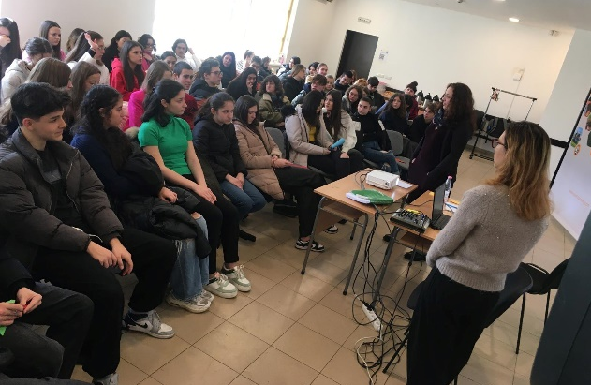
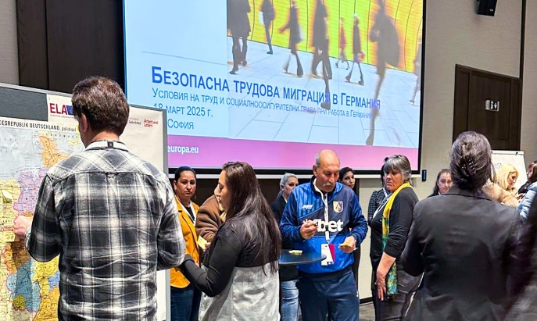

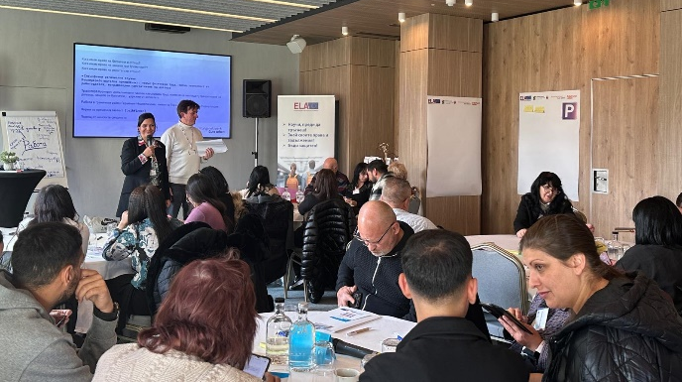
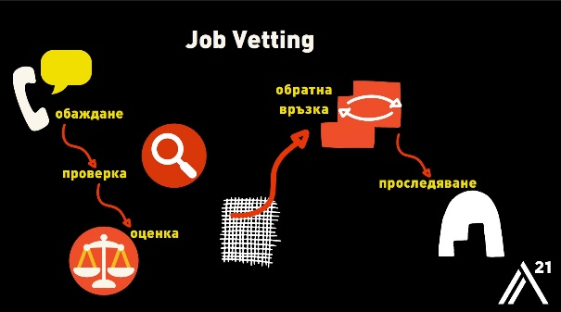
The Bulgarian Model – examples of targeted prevention
Youth empowerment: Academy for volunteers 2025 – Raising awareness & digital literacy; 150 young people from 12 cities in Bulgaria
Early warning and risk detection: Sustainable partnership between NCCTHB and A21 Bulgaria and hotline job vetting service
- Verifying the legitimacy of job offers and preventing exploitation
- 76 % more job vetting requests in 2023 than in 2022
Building trust and knowledge among the most vulnerable: Targeted information sessions for the networks of Roma labour, health and educational mediators in a crucial partnership with the European Labour Authority (ELA)
- 2024-2025: more than 190 Roma mediators trained
- Over 20 municipalities reached

Slide 13
Conclusions
Existing prevention efforts include various activities
There is a strong legal basis, strategic guidance, and evolving practices
Communication strategies and techniques are multifaceted, credible, and practical
Flexibility is essential to respond to local contexts and specific vulnerabilities
Prevention can benefit from standardisation frameworks to ensure consistency and comparability
A clear definition of prevention in the context of THB, along with standards for evaluating the impact of relevant initiatives, is needed

Slide 14
THANK YOU!
Ernesta Rousseva, Chief Expert
National Commission for Combating Trafficking in Human Beings
Tel: + 359 2 807 80 50
e.rousseva@antitraffic.government.bg
office@antitraffic.government.bg
www.antitraffic.government.bg
https://www.facebook.com/NCCTHB

