Slide 1

HEARING OF THE MINOR WITNESS/VICTIM
(under special conditions)
And
The Escape Van Project
MAY 2025

Slide 2
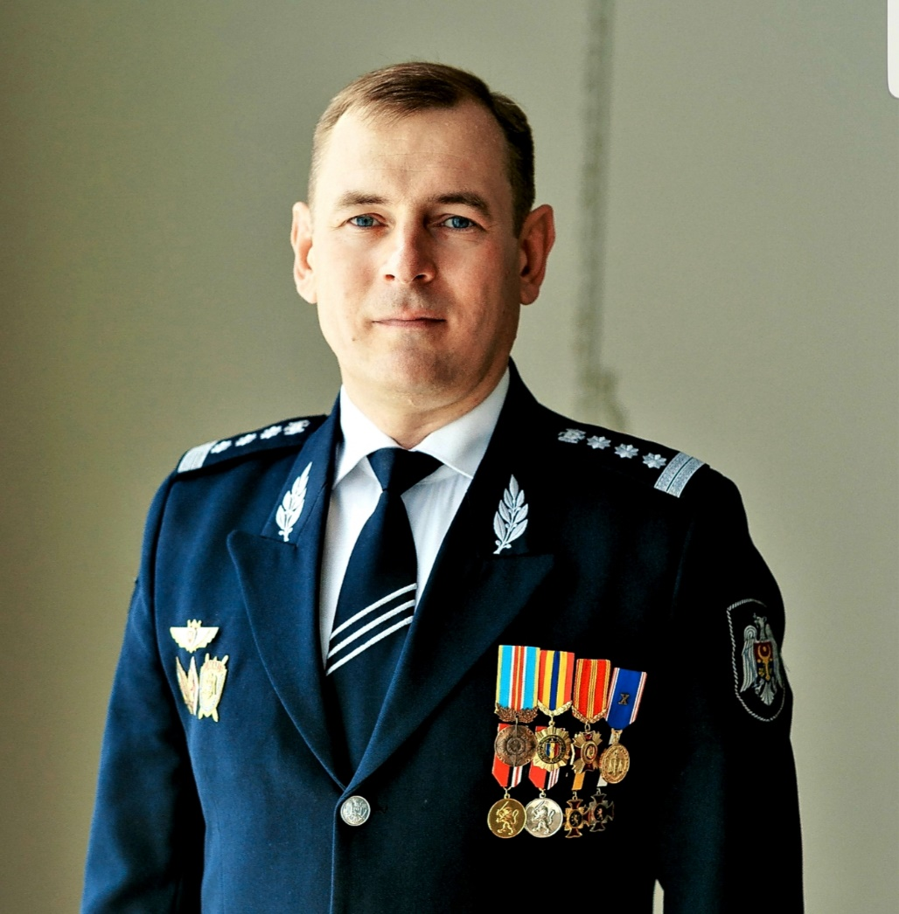
Coordinator
1992 – 2020, employee of the Ministry of Internal Affairs;
2016 – 2020, Head of the General Directorate Prosecution of the General Police Inspectorate of the Ministry of Internal Affairs;
2020 – present, trainer at the “Ștefan cel Mare” Academy of the Ministry of Internal Affairs;
PhD candidate.
Grigore MOGA

Slide 3
Table of contents:
DATA OF THE MINISTRY OF INTERNAL AFFAIRS REGARDING THE PHENOMENON OF HUMAN TRAFFICKING IN THE REPUBLIC OF MOLDOVA
PROCEDURE FOR HEARING THE WITNESS / VICTIM UNDER SPECIAL CONDITIONS
BENEFITS OF HEARING UNDER SPECIAL CONDITIONS
THE ESCAPE VAN PROJECT

Slide 4
Data from the Central Database (CBD) of the Information Technology Service of the Ministry of Internal Affairs. Crimes of Human Trafficking - Article 165 of the Criminal Code and Child Trafficking - Article 206 of the Criminal Code registered during the period 2019 – 2024.

Slide 5
Victims of Human Trafficking and Child Trafficking identified at the national level during the period 2019 – 2024.

Slide 6
Child victims of Human Trafficking identified at the national level during the period 2019 - first 9 months of 2024.

Slide 7
By FORM of EXPLOITATION of child victims of human trafficking identified during the period 2019 – 2024

Slide 8
2.1 International framework
The United Nations Convention on the Rights of the Child states that, due to their vulnerability, children require special care and protection. It places particular emphasis on the primary responsibility of the family for the care and protection of the child, the need for legal and other forms of protection both before and after birth, the importance of respecting the cultural values of the child's community, and the vital role of international cooperation in the realization of children's rights.

Slide 9
2.1 International framework
The Convention ensures the child’s right to be protected by the authorities against all forms of violence, injury or abuse, physical or mental, neglect or negligent treatment, maltreatment or exploitation, including sexual abuse (Article 19).

Slide 10
2.2 National framework
The special hearing procedure for children was introduced into the Criminal Procedure Code of the Republic of Moldova by Law No. 66 of April 5, 2012, which added Article 110¹.
This law was published in the Official Gazette of the Republic of Moldova No. 99 on May 25, 2012, and entered into force on the date of its publication.

Slide 11
2.3 Persoanele audiate în condiții speciale
Criminal procedure provides for the mandatory special hearing of children in criminal cases involving:
sexual offences,
child trafficking,
domestic violence, and
other cases where the interests of justice or of the minor so require.

Slide 12
2.4 Child’s age
With the introduction of the special hearing procedure for children into the Criminal Procedure Code, this procedure has been applied to children under the age of 14, particularly in criminal cases involving sexual offences, child trafficking, or domestic violence.

Slide 13
2.4 Child’s age
The extension of the applicability of the special hearing procedure for minors up to the age of 18 was influenced by the Republic of Moldova’s international commitments, including the ratification of the Istanbul Convention. This convention, adopted by the Council of Europe in 2011, was ratified by the Republic of Moldova through Law No. 126 of June 28, 2022, published in the Official Gazette No. 184 of July 1, 2022.

Slide 14
2.5 Specially arranged spaces
Interview room:
The child;
The interviewer;
If applicable:
The legal representative, depending on the child’s age and availability;
The translator.

Slide 15
2.5 Specially arranged spaces
Observation room:
Investigating judge;
Court clerk;
Prosecutor;
Criminal investigation officer;
Psychologist;
Legal representative.

Slide 16
2.5 Specially arranged spaces
Observation room:
The suspect’s/accused’s lawyer.
NOTE: the participation of the suspect, accused, or defendant is PROHIBITED.

Slide 17
2.6 The hearing procedure
The hearing of a minor witness is conducted by the investigating judge in specially arranged rooms equipped with audio and video recording devices, through an interviewer.
Participants in the hearing shall direct their questions to the investigating judge, who will convey them to the interviewer verbally, via technical devices, or in writing, during a break.
Note: the interviewer is a person invited to mediate the hearing of the minor, who holds a degree in law or psychology and has received special training for this task.

Slide 18
2.7 Duration of the hearing
1 hour without interruption, and a total of no more than 2 hours per day, for minors under the age of 14;
2 hours without interruption, and a total of no more than 4 hours per day, for minors over the age of 14.

Slide 19
3. Benefits of hearing children under special conditions
Protecting mental health - reduces the risk of retraumatization and anxiety;
Creating a safe and child-friendly environment - the child is interviewed in an age-appropriate setting;
Minimizing contact with the defendant - prevents intimidation or influence over the child's statements.

Slide 20
3. Benefits of hearing children under special conditions
Improved quality of evidence - statements are clearer and more credible;
Respect for the best interests of the child - in accordance with international standards (e.g., UN Convention on the Rights of the Child);
Avoidance of repeated hearings - through complete video recording of the hearing.
NOTE: the minor is not summoned to court.

Slide 21
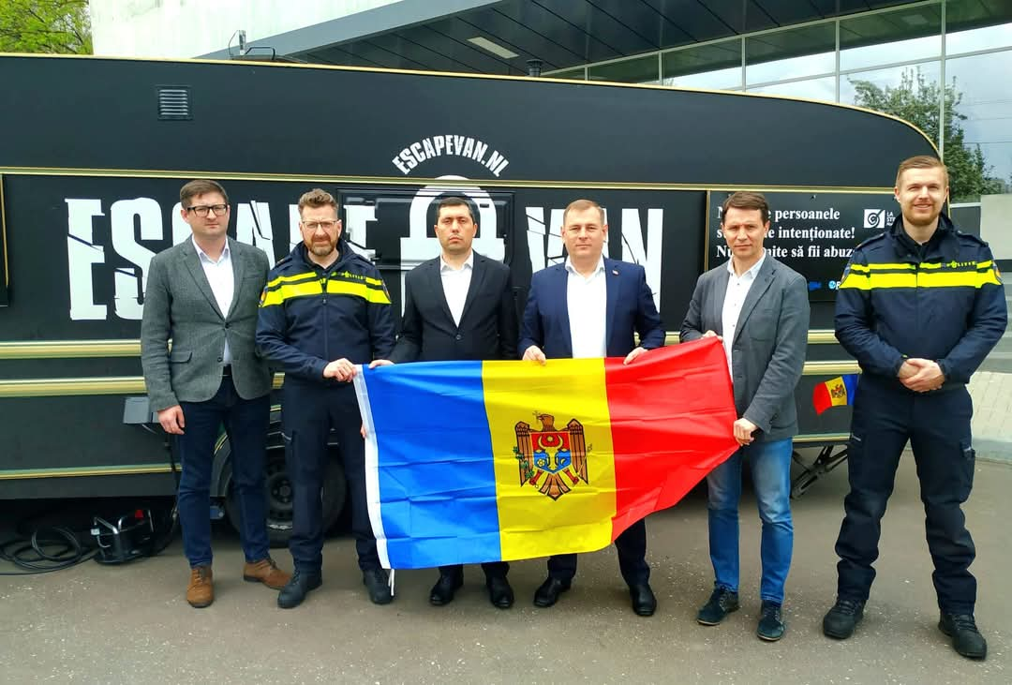
4. ESCAPE VAN Project
The first launch of the project took place between April 27 - May 18, 2023.
2500 people from 18 regions received useful information regarding THB.

Slide 22
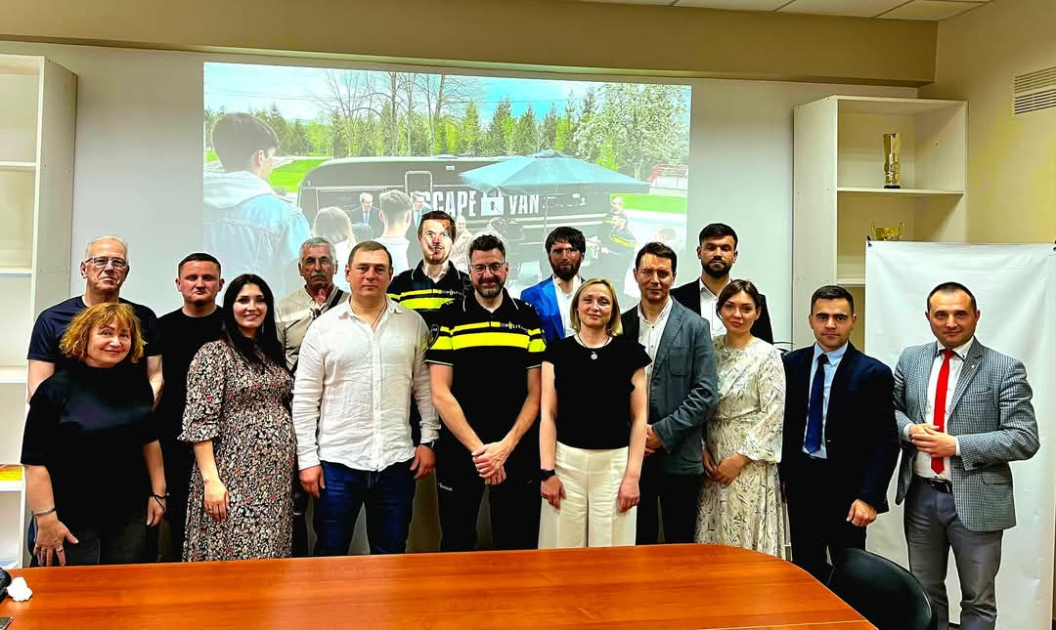
4. ESCAPE VAN Project
The project was implemented by:
1. Open Gate International NGO;
2. Technical University of Moldova(UTM/TUM);
3. ,,Ștefan cel Mare” Academy of the MIA;
4. General Police Inspectorate of the MIA.

Slide 23
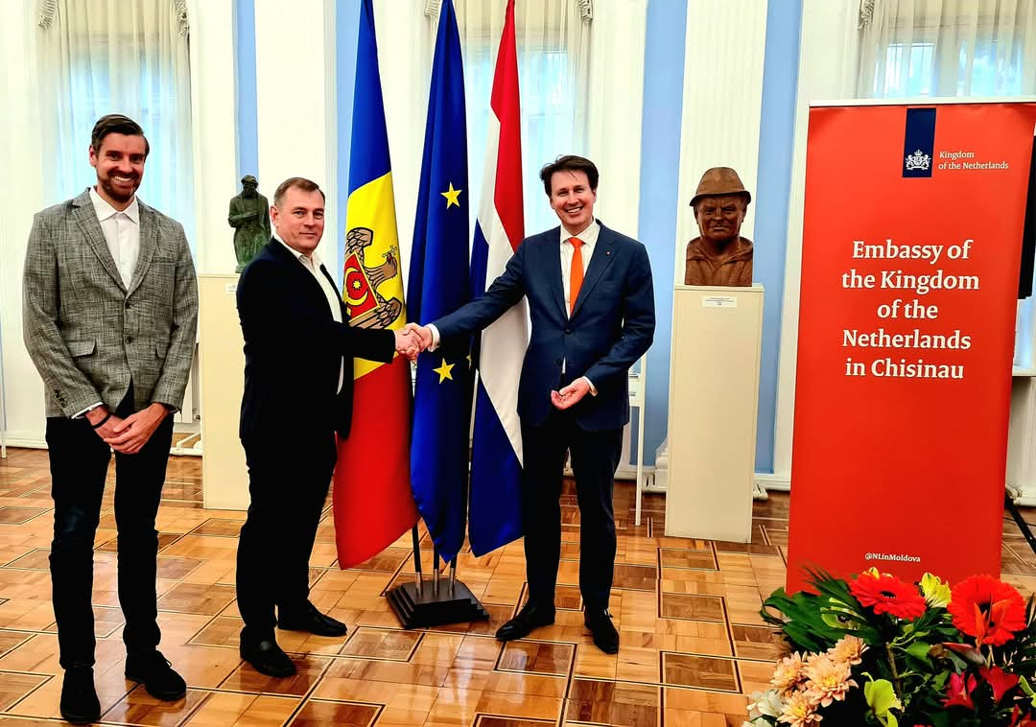
4. ESCAPE VAN Project
The project was realised with the help of the Embassy of the Kingdom of the Netherlands in Moldova!

Slide 24
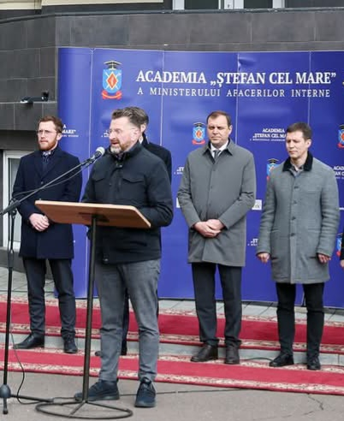
4. ESCAPE VAN Project
On the 9th of April 2025, the equipment of the Escape Van was transferred to the Inițiativă Pozitivă NGO.

Slide 25
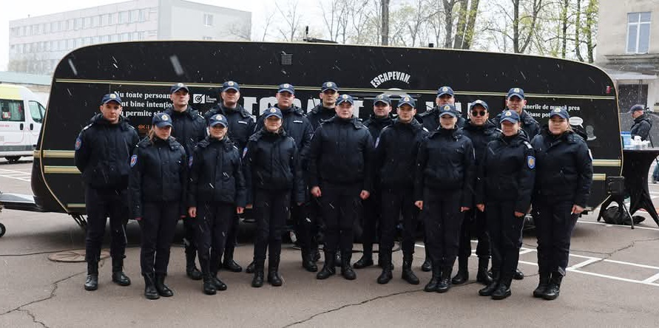
4. ESCAPE VAN Project
The Academy’s students were the first to benefit from the training sessions;
450 police officers were trained;
The project is expected to reach 20 localities, with around 7,000 potential beneficiaries.

Slide 26
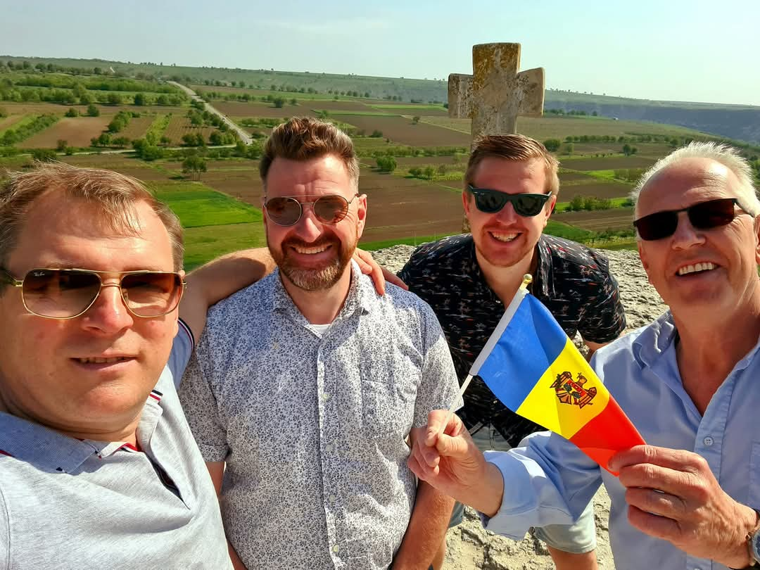
4. ESCAPE VAN Project
Nothing can be achieved without friendship and mutual support.

Slide 27
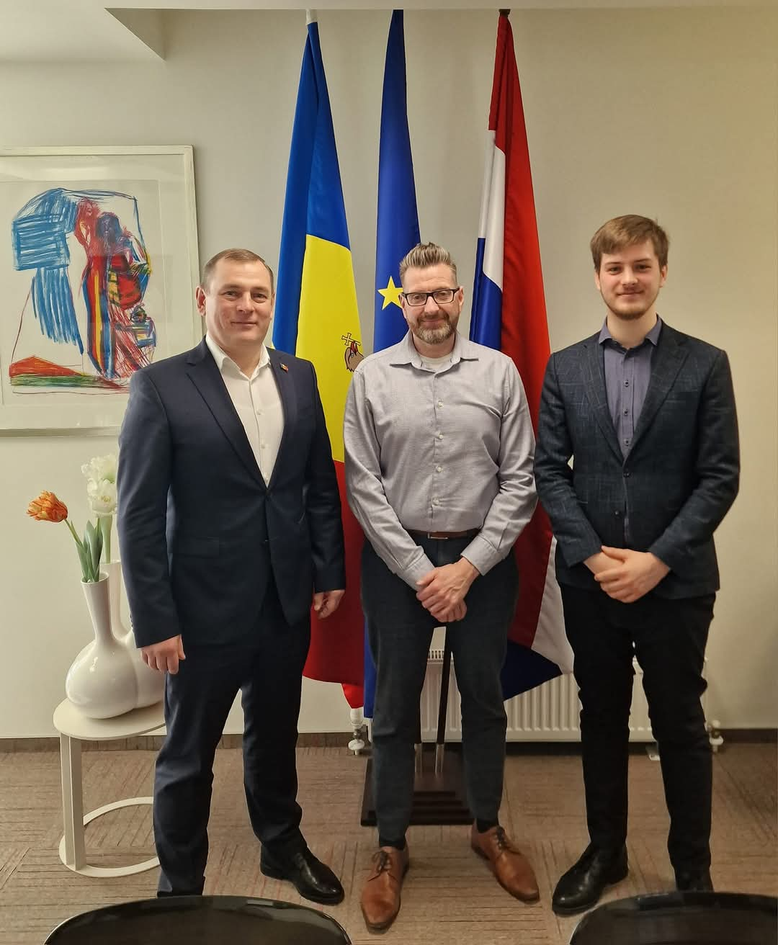
4. ESCAPE VAN Project
With special appreciation to
Jorn van Rij, Ph.D!

Slide 28
Questions?

Slide 29
Thank you for you attention!

