Slide 1


SPATIUM – RESEARCH CENTER

Slide 2
Leveraging educational platforms and AI-driven tools to mitigate the risks of human trafficking through awareness, prevention, and intervention
Catruc Mariana
FCIM, SPATIUM
Zaharia Gabriel
FCIM, SPATIUM

Slide 3

Gamification strategies for enhancing user motivation
Motivation
Games in sensitive perspectives and ethical topics
Challenges and Ethical Considerations
Integrating Artificial Intelligence in Serious Games for Human Trafficking Awareness

Slide 4
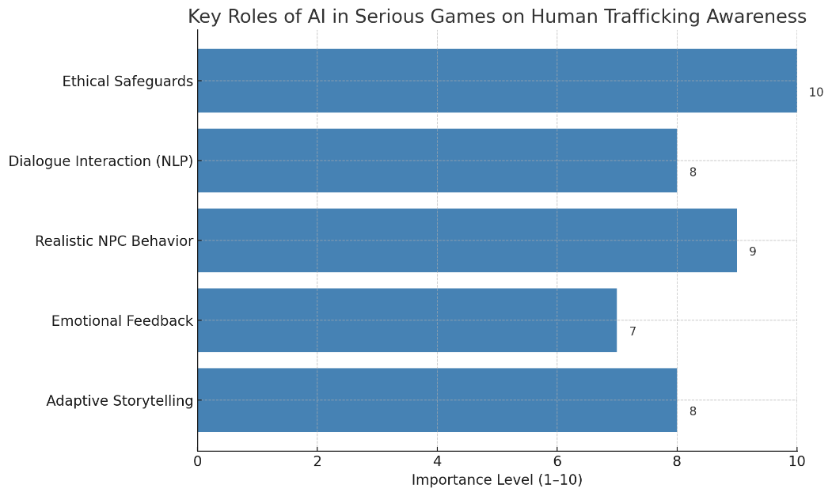
Gamification strategies for enhancing user motivation. Key roles of AI in serious games

Slide 5
Evaluating the landscape. Research insights and differentiation strategy
User interest and validation
Feedback and research analysis
Ethical design reflection and lessons
“Adventure and escapades”

Slide 6
Comprehensive overview of Game features and outcomes
Game overview and narrative structure
Methodology. Game design process
User preferences quiz design
Data analysis
Game Levels ->

Slide 7
Statistics and demographic results
Demographic | Results
Age | 11–18 years
Gender | 53% male, 47% female
Preferred genres | Adventure/Exploration: 62.5%, Interactive chat: 31.9%, Puzzle/Mystery: 22.1%, Visual Novel: 18.2%
Importance of story | “Very important”: 21.8%, “Moderately”: 26.4%, “Not important (prefer action)”: 51.8%
Enjoys puzzle? | Yes: 75%
Preferred game duration | Less than 40 minutes: 68%
Values educational content? | Yes: 70%

Slide 8
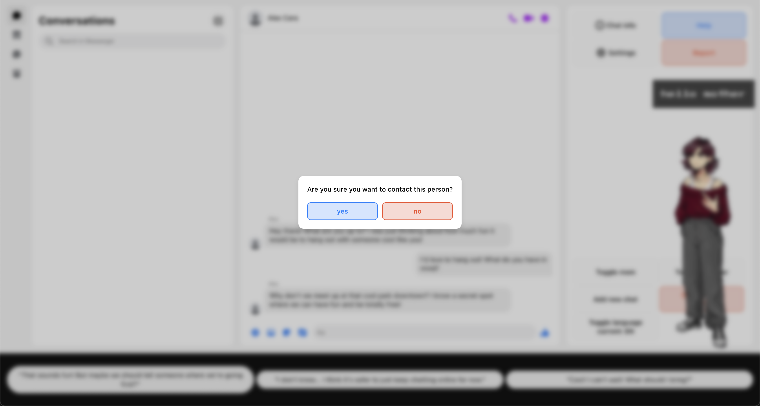
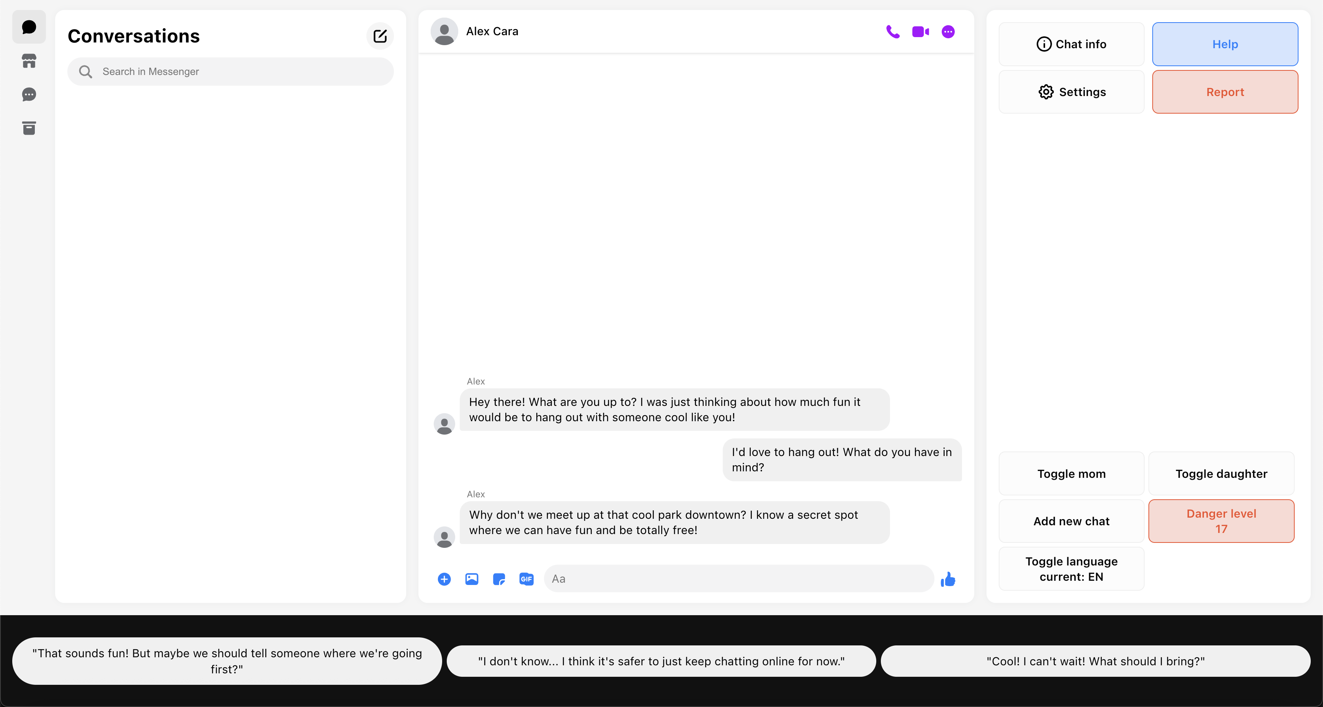
Level 1: The Lure

Slide 9

Level 2: Captivity and control

Slide 10

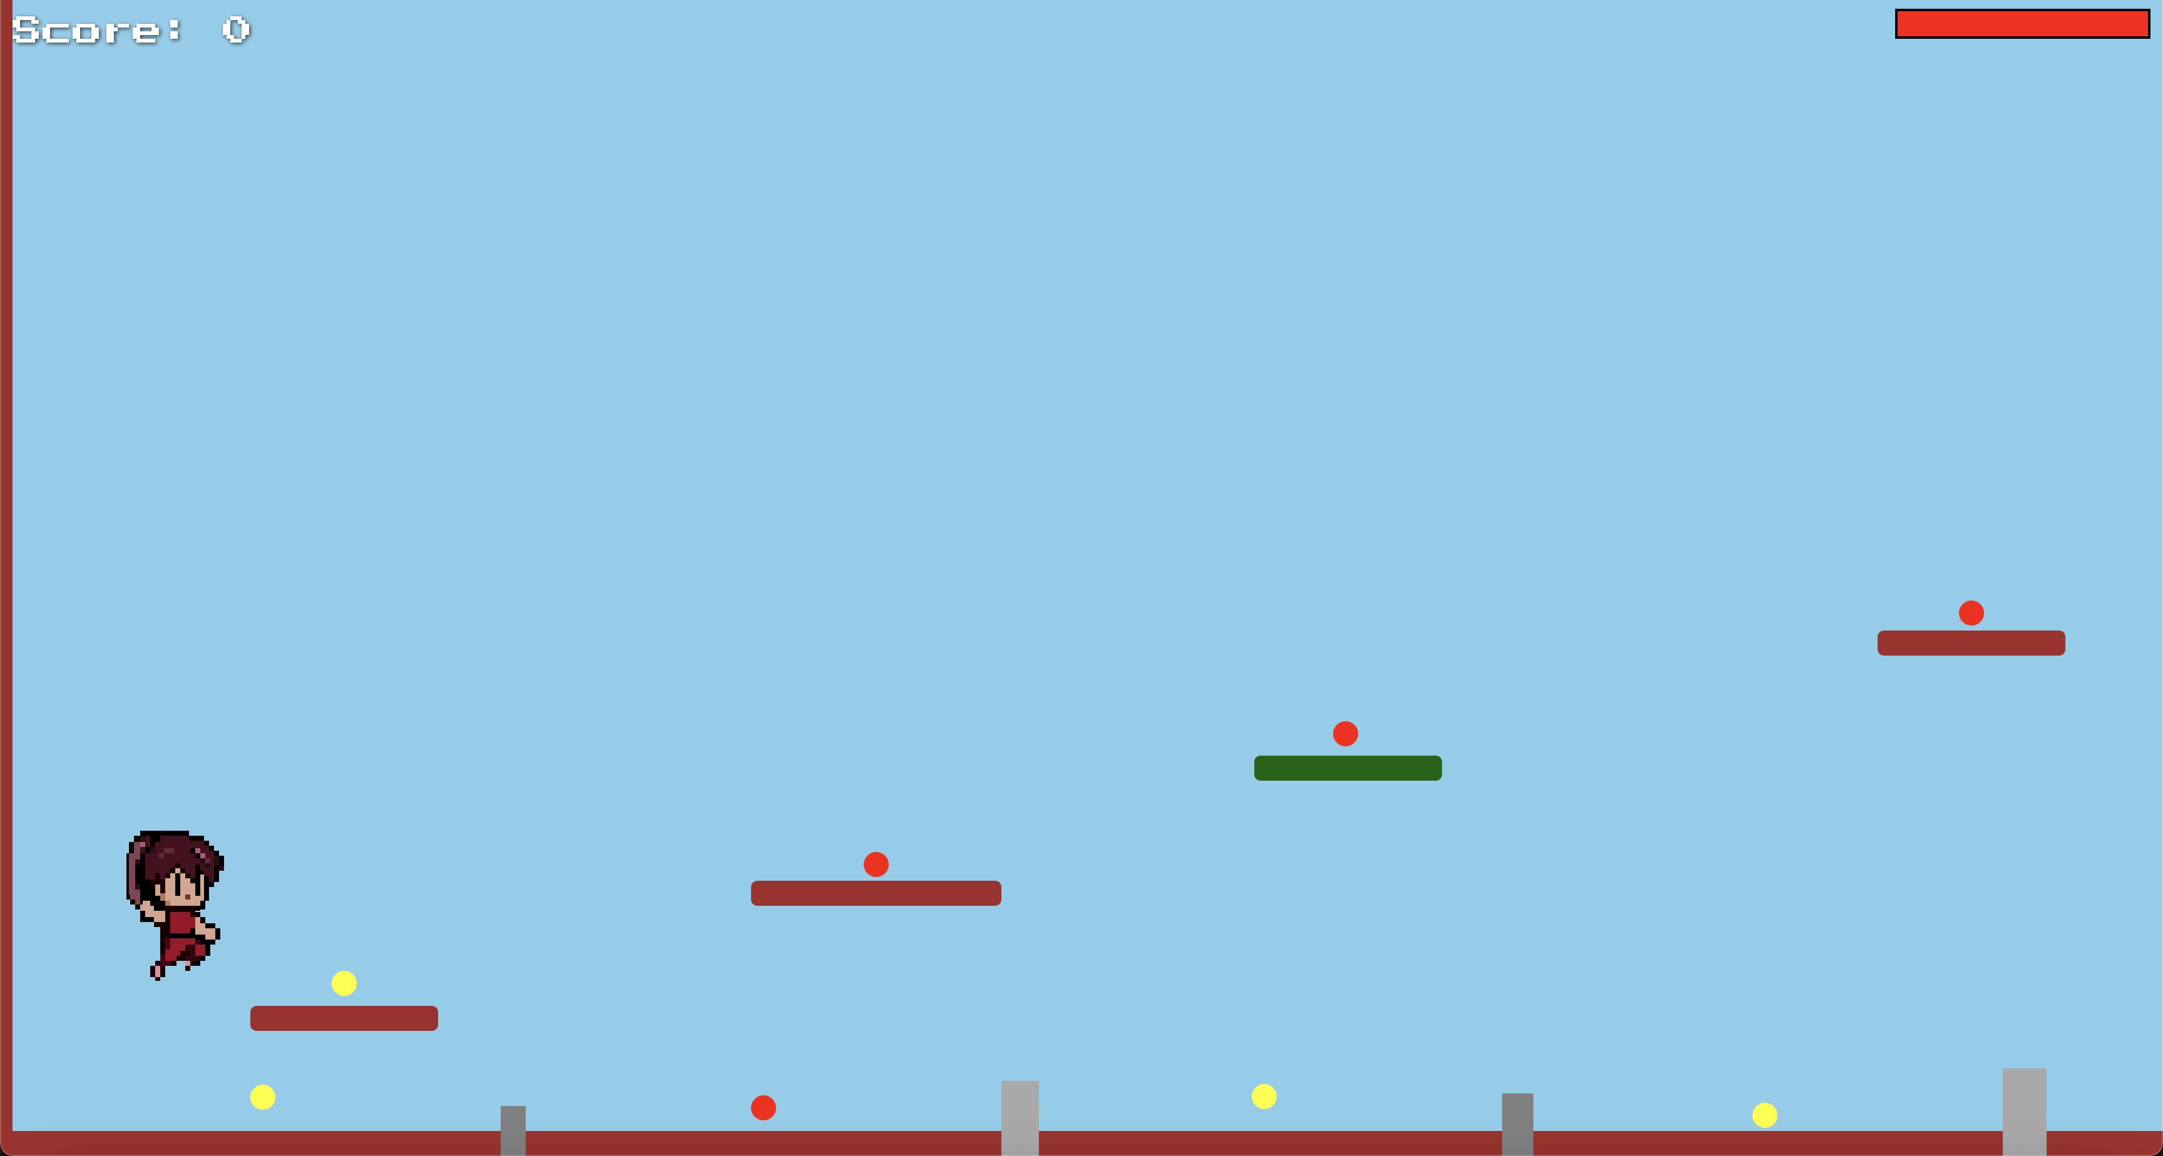
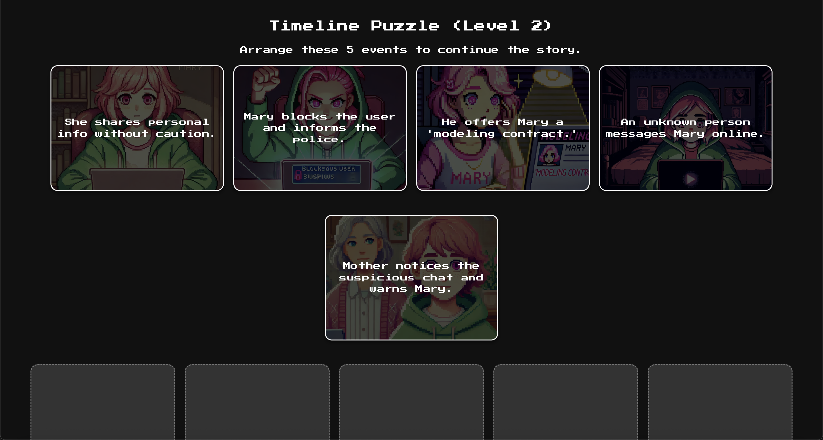
Level 3: The Escape

Slide 11


Level 4: Aftermath and awareness

Slide 12
Demo
(under development)

Slide 13
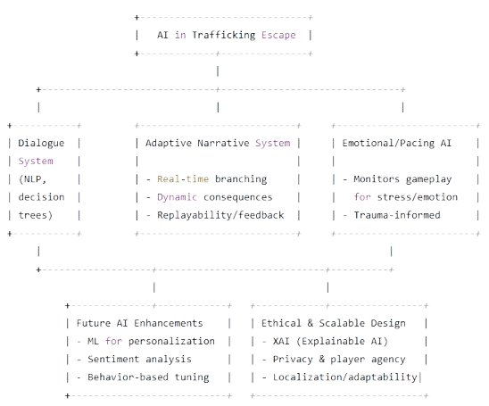
AI integration: scope, capabilities and impact

Slide 14
Q & A ?

