Slide 1
Good practices in collaboration in THB cases
Sanne Spronk

Slide 2

Welcome & introduction
Inez Klapper | Rotterdam University of Applied Sciences (RUAS)
Grateful to University of Pécs & Dutch National Police
Goal: Share developments, strengthen collaboration
Focus: Education, research & action on Trafficking in Human Beings (THB)

Slide 3
Who we are (RUAS)
40,000 students
66 bachelor’s, 26 master’s,
34 associate degree programs
Strong practice-based education model
Minor THB since 2019, 75 students from different universities per year, 30 EC

Slide 4
Main objectives
Expose hidden issues in THB
Train professionals to detect, collaborate, act
Strengthen field practice through education & research
Support predictive policing (e.g., geo-visualization)

Slide 5

Why a centre for education & THB?
Joint initiative with Dutch National Police
Centralizing knowledge on THB: research, education, practice
Focus: Criminal exploitation & social dimensions
Connect: Care – Safety – Research – Education – Practice
Foto: Iris van den Broek

Slide 6
Key activities
Expand and internationalise current minor (2025-2026)
Launch international minor (2026–2027)
Collaborations: Georgia, Hungary, Moldova, Poland, Romania and others
Student & staff exchanges | Joint publications

Slide 7
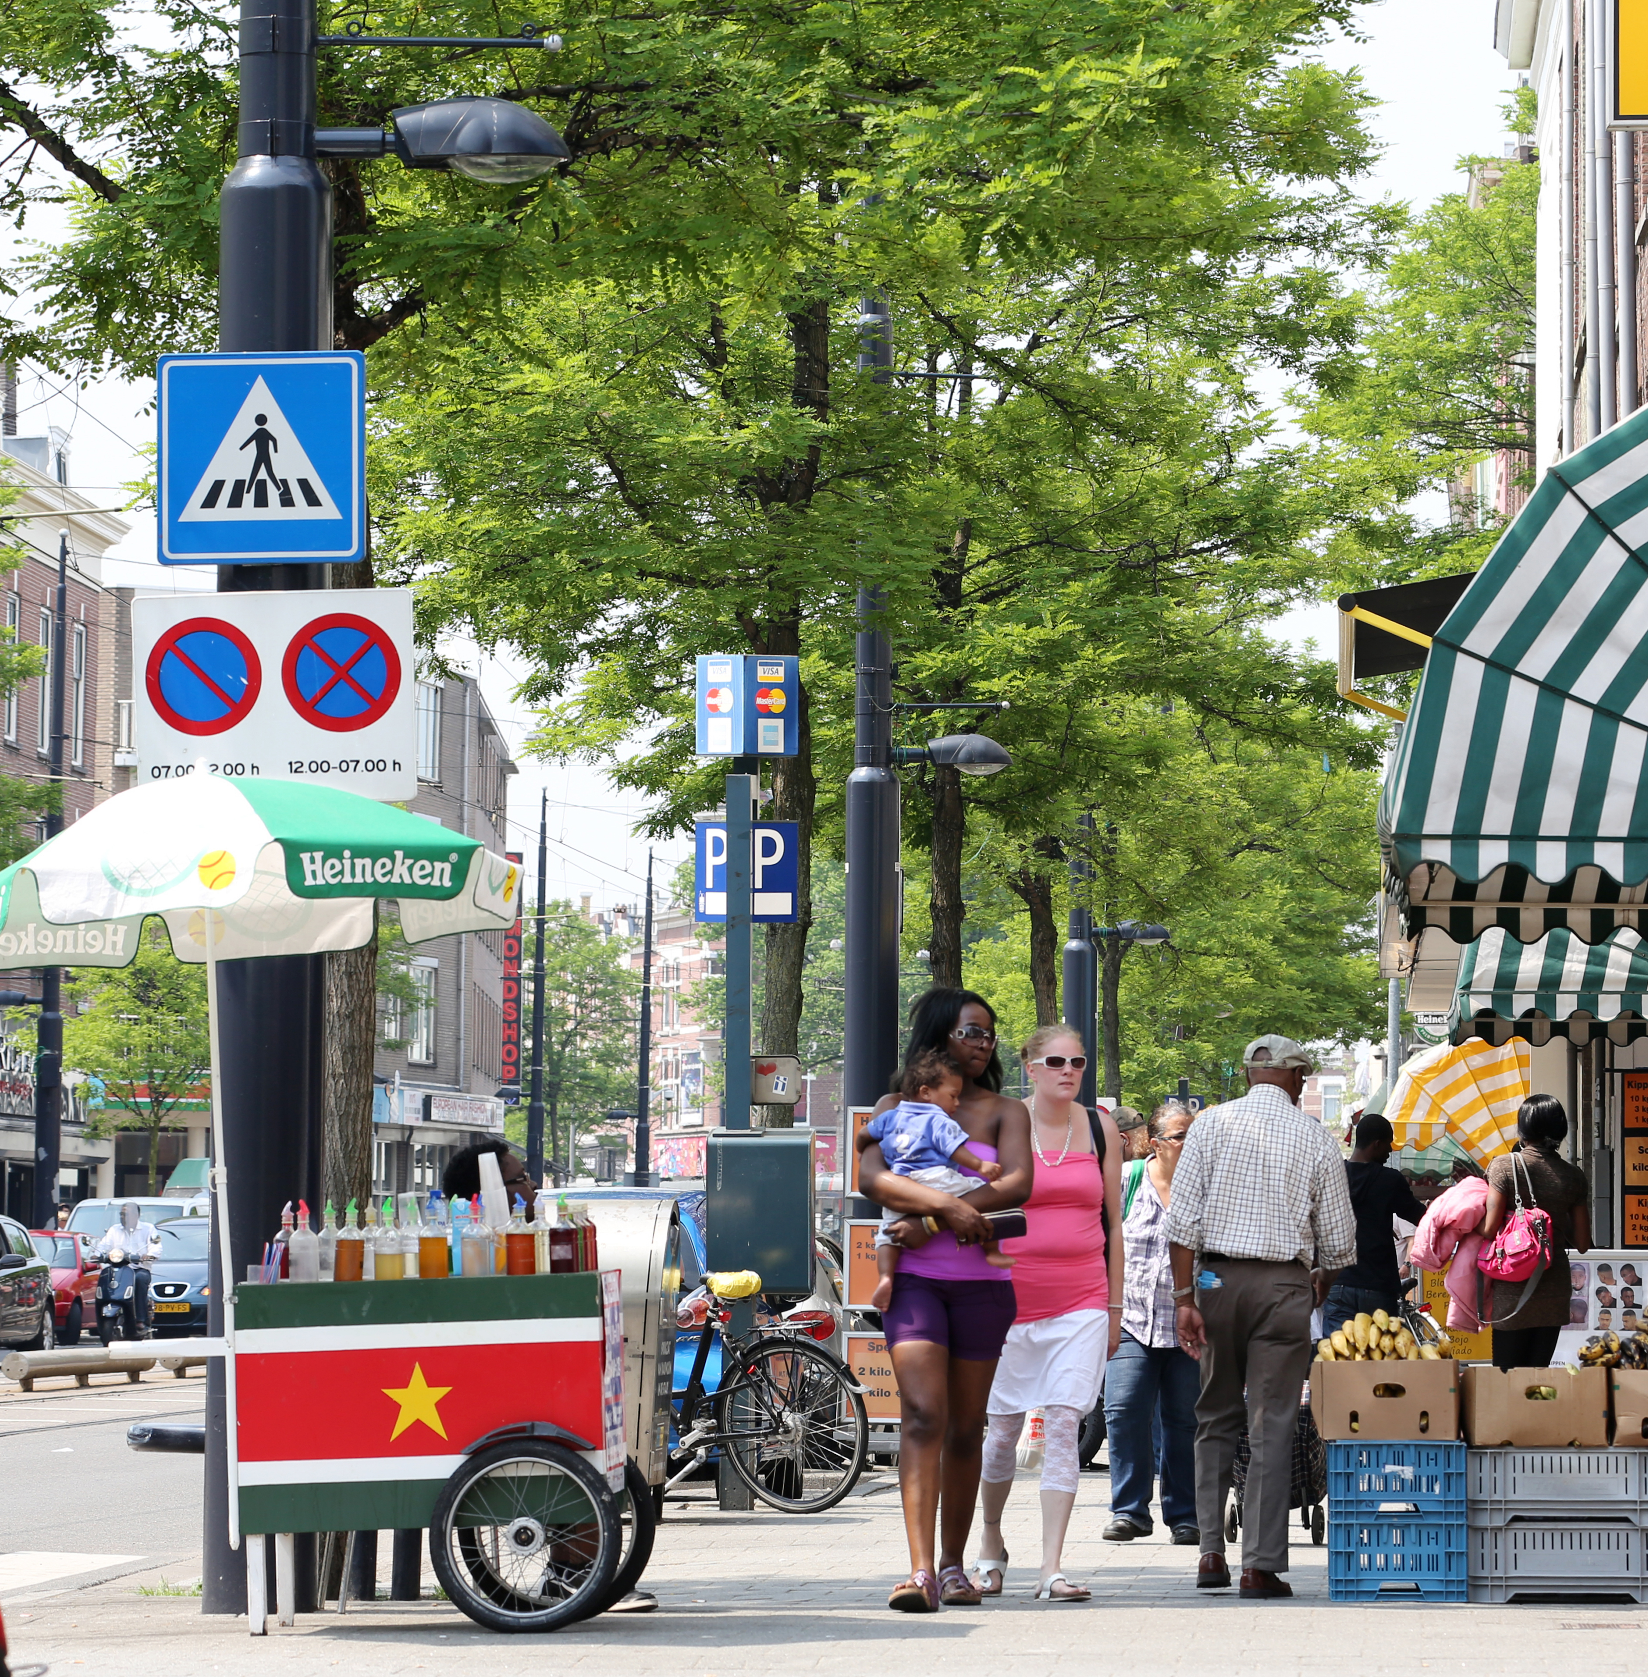
Our vision
Empower victims | Resocialize perpetrators
Preventive, data-driven approach
Train transdisciplinary professionals
Stronger knowledge exchange with chain partners
Involve vulnerable communities

Slide 8
Closing invitation
The Expertise Centre offers added value in research & prevention
Let’s collaborate across borders for effective THB solutions
Join us in shaping the future of anti-trafficking education
If you are interested to in doing this together: let’s meet directly after the programme at 15.30.
Thank you for your attention

