Slide 1

Identification and referral system for the victims of human trafficking in Hungary
15/05/25 – Pécs
Péter Hudák
Ministry of Justice (Hungary)

Slide 2
Background to the introduction of the EKAT System
The creation and launch of the EKAT System
The structure of the EKAT System
The possible further development of the EKAT System

Slide 3
Background to the introduction of the EKAT System (relevant legislation, legal environment)
  No. 197. Council of Europe Convention on Action against Trafficking in Human Beings
  Act C of 2012 on the Criminal Code (Criminal Code)
  Government Decree No.354/2012. (XII.13) on the identification order of victims of trafficking in human beings (THB Decree)
  Directive 2011/36/EU of the European Parliament and the Council (on preventing and combating trafficking in human beings and protecting its victims, and replacing Council Framework Decision 2002/629/JHA)

Slide 4
The „THB Decree”
Rules of identification
Relevant concepts (interview, identification bodies, shelters…etc.)
Identification form
Identification flowchart

Slide 5
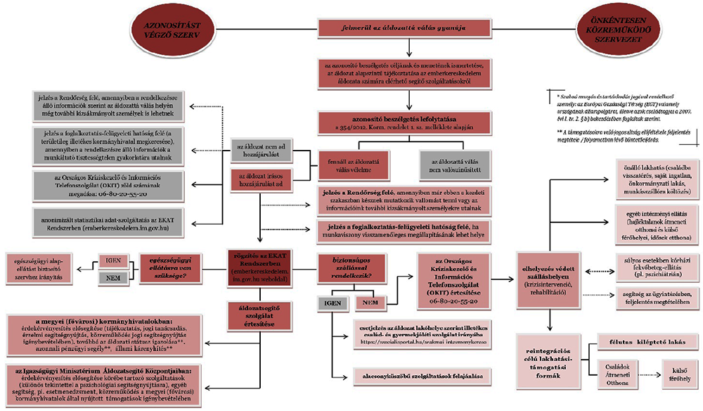
The identification flowchart

Slide 6
The creation and launch of the EKAT System
ISF No.-5.4.1/2-2016-00001. „Establishment of a web-based system to assist the referral mechanism of trafficking in human beings and to monitor trends in trafficking in human beings”
Reasons and objectives

Slide 7
Launch of the EKAT System
The EKAT System is operational since November 2017
3,600+ organisations (identification bodies)
5,700+ users
1,200+ identification forms

Slide 8
The structure of the EKAT System
Unique, custome software solution
Web-based user interface
3 main units:
  Public interface
  Form management module
  Statistics module

Slide 9

Public interface (https://emberkereskedelem.im.gov.hu/fooldal)

Slide 10
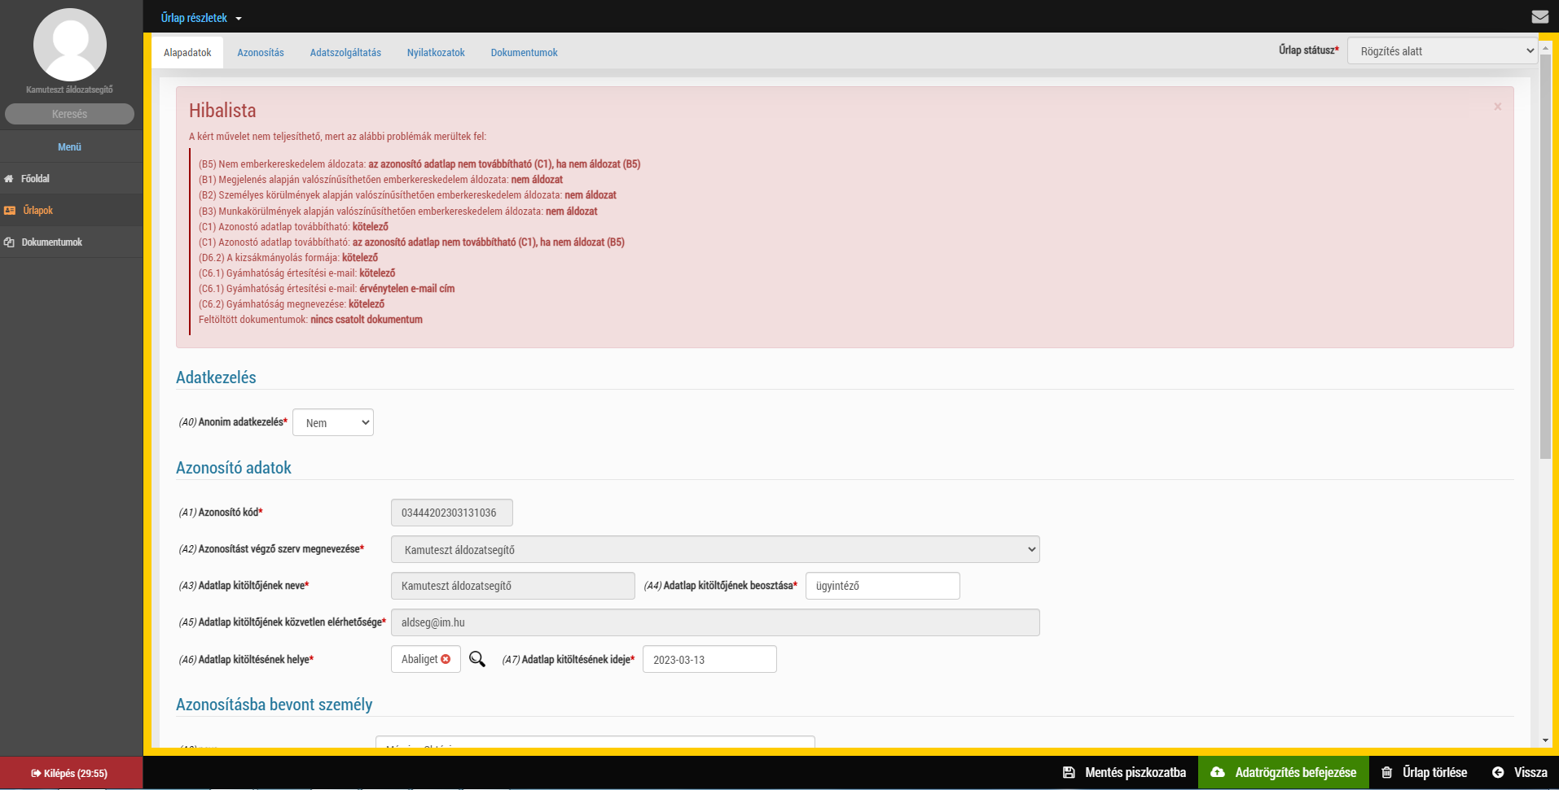
Form management module

Slide 11
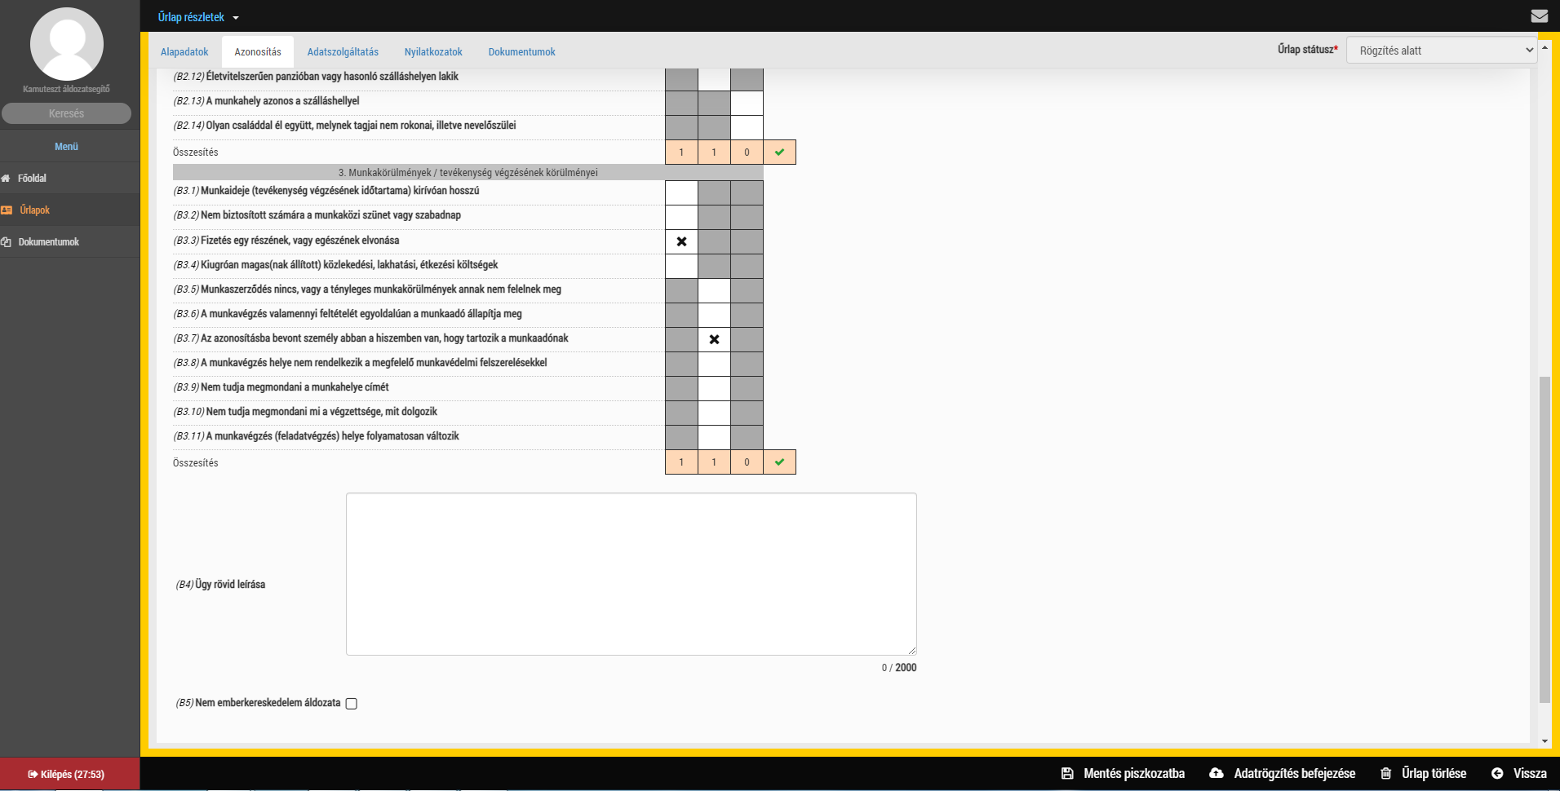
Form management module

Slide 12
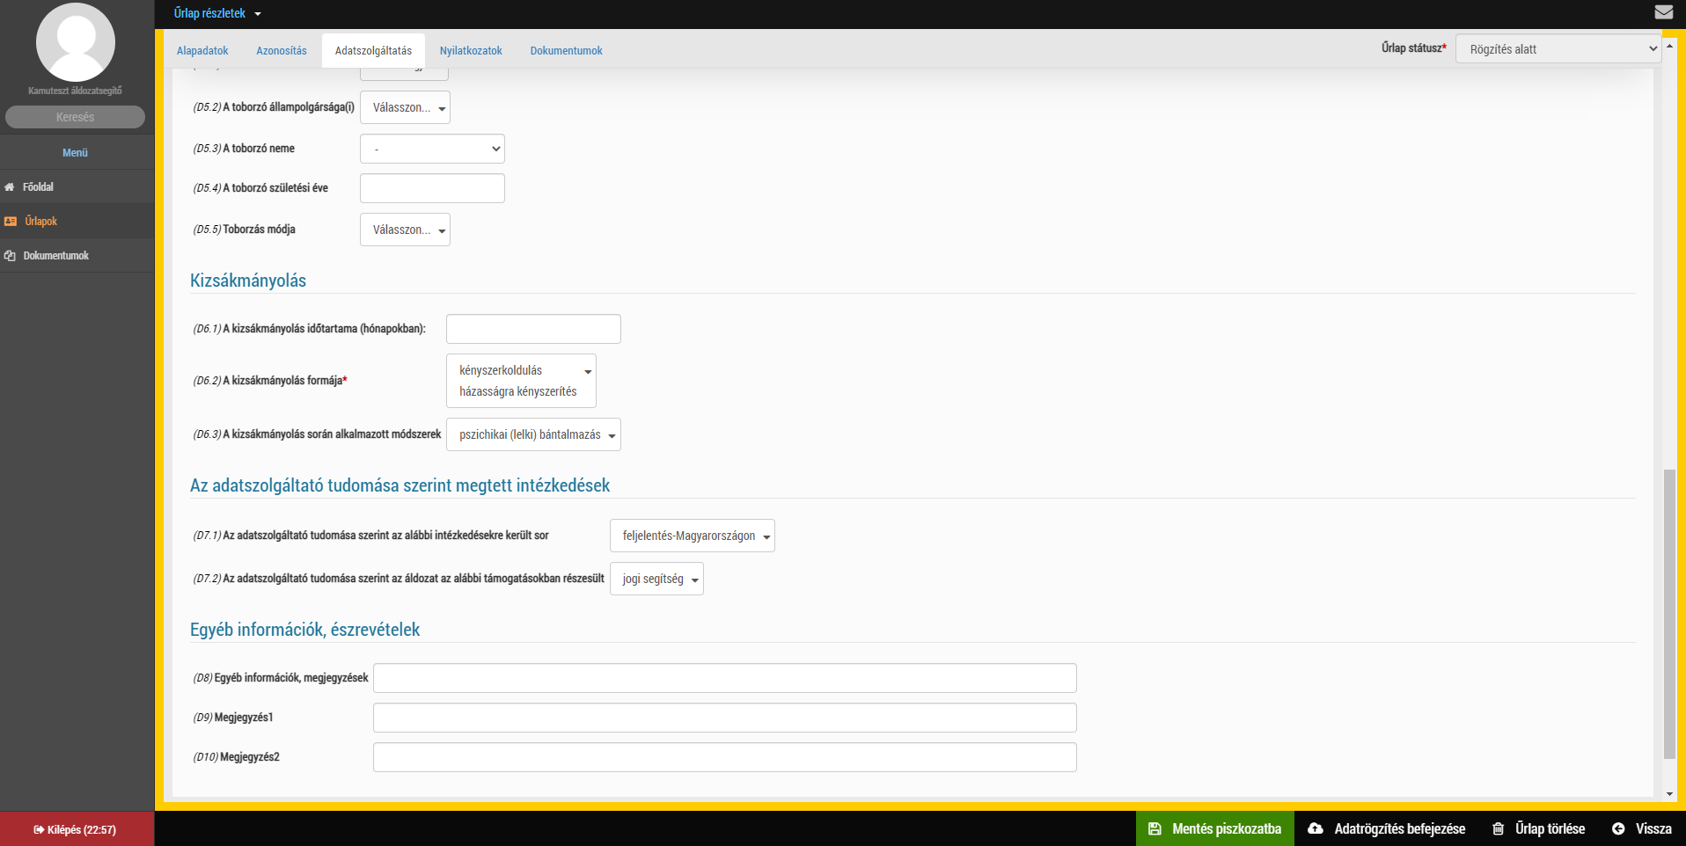
Form management module

Slide 13
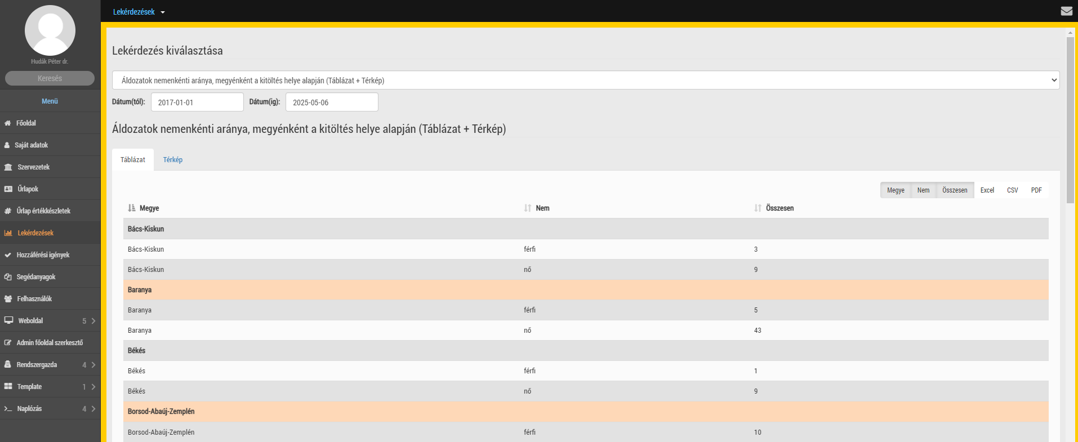
Statistics module

Slide 14
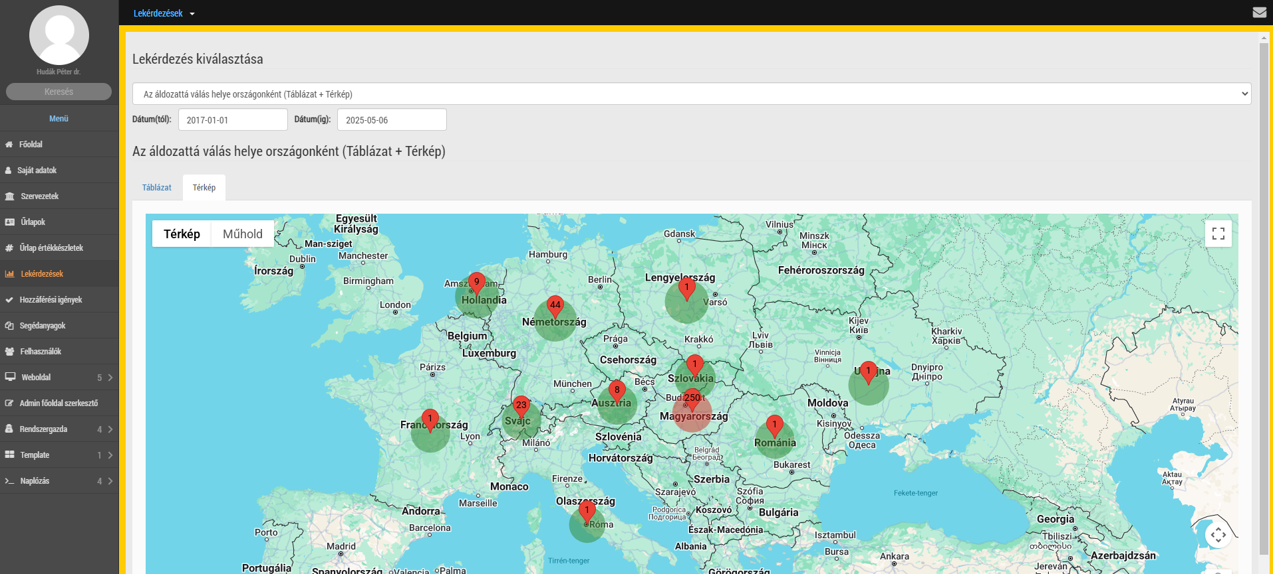
Statistics module

Slide 15
Users
Multiple user groups
Multiple authorisation levels
Online registration

Slide 16
Further development of the EKAT System
2022: ISF No.-5.2.2/23-2022-00001. “Implementation of tasks aimed at preparing the further development of the EKAT System”
  1 technical specification
  1 system design

Slide 17
Further development of the EKAT System
2024: ISF No.-1.1.2-24. „Information and communication technology development in the field of criminal data exchange”
  Technological rewriting, quality assurance
  Changes in legislation
  Interfacing with other IT systems
  Follow-up module
  Consular module
  Expert visits, studies
  New educational system
  User-friendly design
  New maintenance solutions

Slide 18
Thank you for your kind attention!

